Slide 1
Coaching approaches in Addiction
Raising our awareness & understanding
Holly Crosby
Notes:
Introduce topic. We can probably all bring to mind a patient, family/friend with an addiction. Lots is hidden too.
Action on Addiction – campaign for Addiction to get the same level of funding/support as MH services.
2023 survey of 2000 people, 1062 adults have either personal experience or someone they know with addiction, 813 said someone close to them.

Slide 2
Addiction
What do we mean by addiction?
When we no longer have control over using the substance or in the activity. Without it we can have ‘withdrawal symptoms’ both mentally and physically.
Notes:
Addiction - when we no longer have control over using the substance or in the activity. And without it we can have ‘withdrawal symptoms’ both mentally and physically.
Harm…
Question: What can we become addicted too? Menti/poll on zoom?

Slide 3
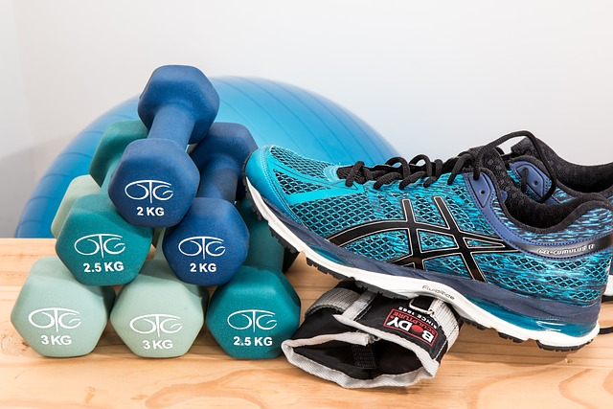
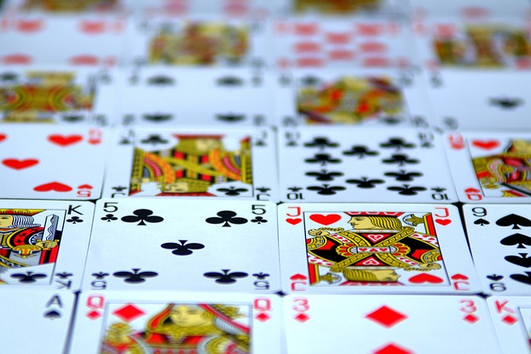
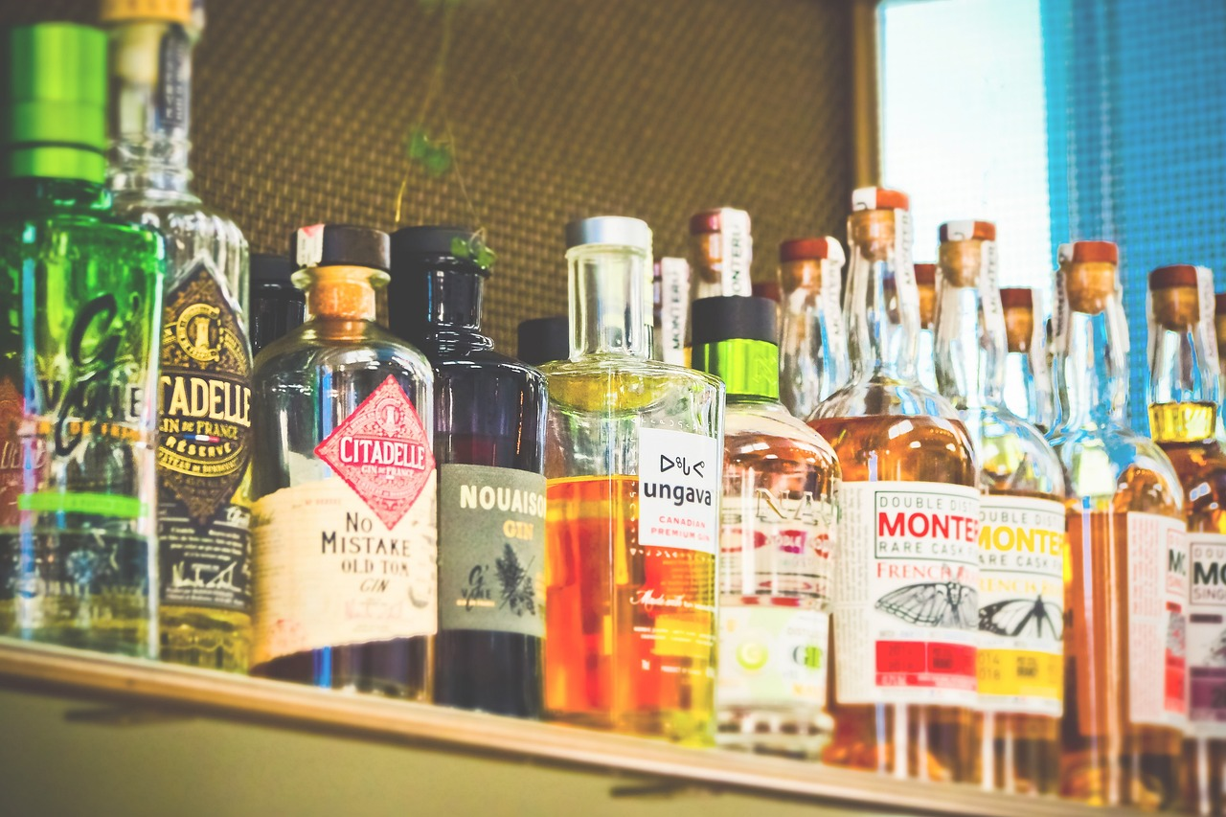
Notes:
Alcohol, drugs, gambling, phone, shopping, gym as examples. There are so many things we can become addicted too! And not all of them will be seen as problematic yet for that person it will be.
When we see all the negatives it’s difficult to understand why this person carries on.
Remember, they can still experience the good (even if that’s blocking out trauma) alongside the problems or they hope to get back to a time when it was good and manageable.
Dependence is on a continuum. Lots of these started as things that are good – that make you feel happy, that are encouraged etc but at some point this can change…bring in tolerance and dependence.

Slide 4
Addiction
Dependence : Physical & Psychological
Physical - sweating, shaking, hallucinations etc.
Psychological – feel you need it to relax, de-stress etc.
What is Tolerance?
Ou body becomes used to what we are exposing it too and in turn it needs more for the same effect
Notes:
Dependence – Physical: sweating, shaking, hallucinations etc when you don’t drink.
Psychological – feel you need it to relax, de-stress etc.
No longer have control over it. Need it etc
Tolerance – body adapts and becomes used to it. Need more for same effect.

Slide 5
Question
What stops people asking for help?
What are the risks of this?
Notes:
Alcohol – lots of people drink choose to drink it as a teenager/adult and none of us start this by having a high tolerance or by being addicted.
Chat box: What stops people speaking up? Comment on risk of hidden addiction.
How do we react to those who we come across that are under the influence?

Slide 6
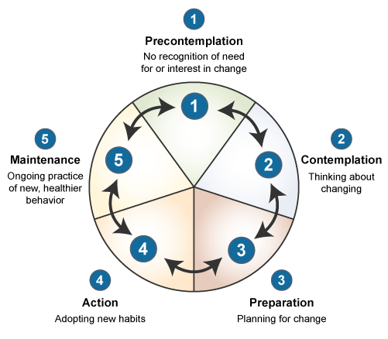
Cycle of Change
Transtheoretical model- Prochaska and DiClemente (1980's)
Based on substance abuse
Typically, someone with an alcohol addiction will go round 8 times before making a lasting change
Notes:
I will focus on alcohol as that’s where most of my experience is. But we can use a lot of the same principles for other addictions.
Talk through cycle – it can help us to understand where someone is at in terms of reediness for change.
Drinker often in Precontemplation, maybe contemplation
Family/friends/colleagues/health care system – Action!
Miss match – conflict will happen. As an alcohol counsellor I had to join them in contemplation. Tell me about it, what's good, what did it/does it give you?
Point out reality – I’m hearing this and I’m also hearing this. You tell me this and what I see is this.
Ultimately like with anything we support people with, we can raise awareness, and we can encourage change, but we can’t make change happen or control that person and their actions. Talk about RAFT support & David/Brian.

