Slide 1
Time Management Skills for Care Co-ordinators
Peak Health Coaching Ltd

Slide 2
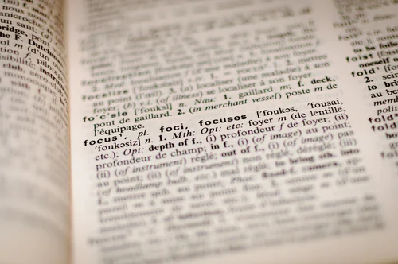
Collins Dictionary:
“Time management is the process of deciding on the order in which you will do tasks, and making sure that they are done on schedule”

Slide 3
Activity - Menti
What gets in the way of effective
time management for you?
Notes:
Needs question on Menti

Slide 4
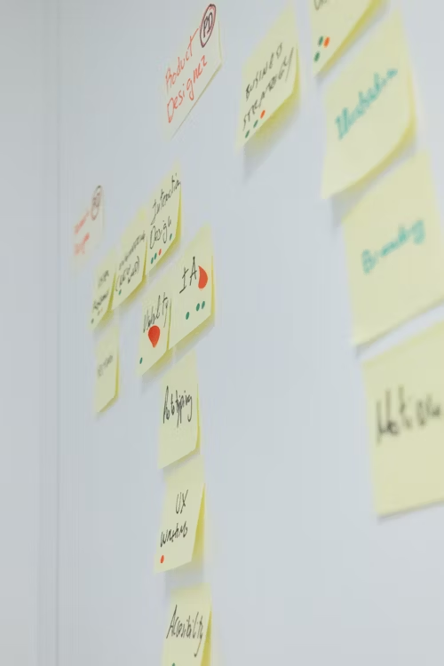
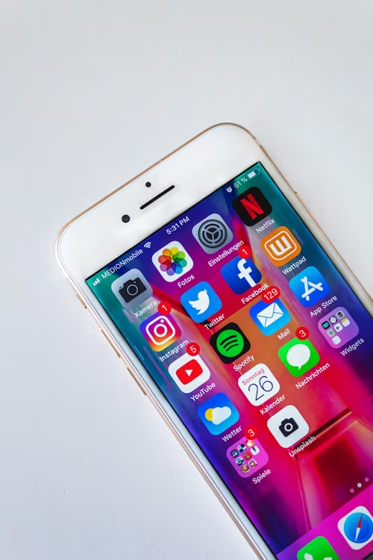
Common Time Stealers
Not Setting Goals
Failing to Keep a To-Do List
Not Prioritising
Procrastination
Distractions
Interruptions
Taking on Too Much.

Slide 5
Time Management Tools

Slide 6
Understanding how you spend your time Using a Time Audit Tool
Time | Task | Observations
6.00am – 7.00am
7.00am – 8.00am
9-.00 – 10.00am
Can you spot any themes or patterns?
Can you group similar tasks?
Can you change habits e.g. how often you check emails during the day?

Slide 7
The Pomodoro Technique
Break down your work into intervals
Choose a task you need to get done
Set a timer (e.g., for 25 mins)
Focus on the task at hand
When the timer rings, make a note of where you’re up to
Take a short break
Repeat steps two to five.
Notes:
Francesco Cirrillo, uni student, first used a tomato shaped timer – ‘any progress is good progress’
Improves focus
Minimises distractions
Prevents burnout (regular breaks)
Boost motivation

Slide 8
The Urgent/Important Matrix
Urgent and important (Do it now) | Not urgent but important (Diary it)
Not urgent and not important (Dump) | Urgent but not important (Delegate or Discuss with Manager)
Notes:
Reduces risk associated with lists if priorities change

Slide 9
Parkinson’s Law
“Work expands so as to fill the time available for its completion.”
Options:
(For the very brave!) - try working without a computer charger
Get it done early on
Set a deadline
Limit time for tasks.
Notes:
British historian Cyril Northcote Parkinson became famous for the phrase “work expands so as to fill the time available for its completion.” In other words, the amount of time you give yourself to complete a specific task is the amount of time it will take you to complete that task.
How it works:
Try working without a computer charger. This will force you to finish a project before your computer dies.
Get it done early. Instead of finishing an essay by midnight, try to get it done by noon.
Set a deadline. Give yourself a set time to do something—and then cut it in half.
Limit time for tasks. Give yourself only 20 minutes in the morning to answer emails.
Types of people this works for:
Procrastinators
People who work well under pressure

Slide 10
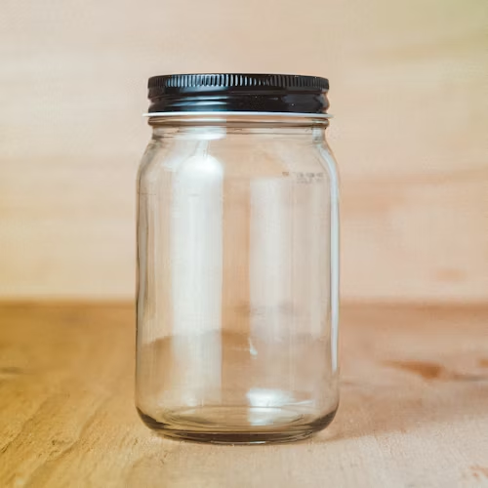
Pickle Jar Theory
Imagine a pickle jar full of sand, pebbles, and rocks.
The sand is at the bottom and the rocks sit at the top.
The sand: This represents disrupting elements of your day, such as phone calls, text messages, emails, social media, etc.
The pebbles: This represents tasks that need to be completed, but can be done on another day or by someone else.
The rocks: These are the most important tasks that need to get done today.
Notes:
This theory helps you figure out what is useful and what is not useful in your daily life. It allows you to plan tasks with time to spare and set priorities for your day.
Begin by thinking about how your tasks for the day would fit into the above categories.
Then make a task list starting with the rocks and ending with sand (if time permits). Include an honest time estimate next to each.
Try not to plan more than six hours of an eight-hour working day. This will leave buffer time for the pebbles and sand.
Types of people who will benefit from the Pickle Jar theory:
Visual people
Concrete thinkers

Slide 11
Menti - minimising interruptions – what works for you?
Notes:
Caveat for parents/carers re turning phone off – may not always be possible
Notifications – email,WhatsApp / Messages on own phone
Move away – tell story of woman with desk by printer and effectively in a corridor
Go into work earlier – caveat – not all the time – wellbeing
Not available – note on door – note in outlook – or you can tell people

Slide 12
How to minimise interruptions
Put your phone on silent (and off vibrate). Better still turn it off! (Try it for an hour)
Turn off notifications
Close software and apps you’re not using right now
Schedule specific tasks
Work from home
Schedule ‘reactive’ time
Move away from your normal working area
Go into work earlier
Mark yourself as “not available” for a period of time
Be assertive!
Notes:
Caveat for parents/carers re turning phone off – may not always be possible
Notifications – email,WhatsApp / Messages on own phone
Move away – tell story of woman with desk by printer and effectively in a corridor
Go into work earlier – caveat – not all the time – wellbeing
Not available – note on door – note in outlook – or you can tell people

Slide 13
Stephen Covey
Concern
Influence
Control
Notes:
Consider where you are expending your energy – mental or otherwise

Slide 14
Self Care

Slide 15
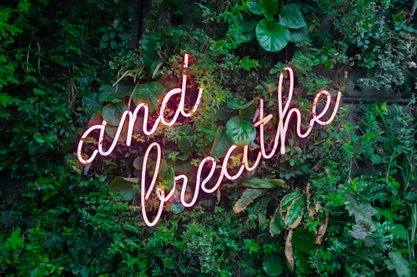
Appreciating when you have increased energy and focus so that you can plan your work effectively
Your natural body rhythms:
Time of the day / Day of the week
Women - time of the month/perimenopause/menopause
Setting impossibly high standards for yourself
Giving yourself credit and kudos and being kind to yourself
Asking for help when you need it
General self care around sleep, hydration etc
Get out in nature
Mindfulness (taking notice)
Notes:
Give me a wave if you’re an early bird… or a night owl? There are different times at which we feel our best.

Slide 16
Moving forward - Menti
What are you going to try to impact positively on your time management?
What will the benefit be?

